Slide 1
Chapter 4 Mathematical Functions, Strings, and Objects

Slide 2
Motivations
Suppose you need to estimate the area enclosed by four cities, given the GPS locations (latitude and longitude) of these cities, as shown in the following diagram. How would you write a program to solve this problem? You will be able to write such a program after completing this chapter.

Slide 3
Objectives
To solve mathematics problems by using the functions in the math module (§4.2).
To represent and process strings and characters (§§4.3-4.4).
To encode characters using ASCII and Unicode (§§4.3.1-4.3.2).
To use the ord function to obtain a numerical code for a character and the chr function to convert a numerical code to a character (§4.3.3).
To represent special characters using the escape sequence (§4.3.4).
To invoke the print function with the end argument (§4.3.5).
To convert numbers to a string using the str function (§4.3.6).
To use the + operator to concatenate strings (§4.3.7).
To read strings from the keyboard (§4.3.8).
To solve the lottery problem using strings (§4.4).
To introduce objects and methods (§4.5).
To introduce the methods in the str class (§4.6).
To program using characters and strings (GuessBirthday) (<LINK>§4.7.1</LINK>).
To convert a hexadecimal character to a decimal value (HexDigit2Dec) (<LINK>§4.7.2</LINK>).
To format numbers and strings using the format function (§4.8).
To draw various shapes (§4.9).
To draw graphics with colors and fonts (§4.10).

Slide 4
Python Built-in Functions

Slide 5
Built-in Functions
>>> max(2, 3, 4) # Returns a maximum number
4
>>> min(2, 3, 4) # Returns a minimum number
2
>>> round(4.51) # Rounds to its nearest integer
5
>>> round(4.4) # Rounds to its nearest integer
4
>>> abs(-3) # Returns the absolute value
3
>>> pow(2, 3) # Same as 2 ** 3
8

Slide 6
The math Functions
MathFunctions

Slide 7
Problem: Compute Angles
Given three points of a triangle, you can compute the angles using the following formula:
ComputeAngles

Slide 8
Simple exercise
Given the coordinates of a right triangle, write the formula for computing the hypotenuse.
(x1,y1), (x2, y2), (x3, y3)
Assume x2y2 has the right angle.

Slide 9
Given the coordinates of a right triangle, write the formula for computing the hypotenuse. (x1,y1), (x2, y2), (x3, y3). c = math.sqrt(a**2 + b**2)
#LiveExample 4.2 ComputeAngles.py
import math
x1 = float(input("Enter x-coordinate for Point 1: "))
y1 = float(input("Enter y-coordinate for Point 1: "))
x2 = float(input("Enter x-coordinate for Point 2: "))
y2 = float(input("Enter y-coordinate for Point 2: "))
x3 = float(input("Enter x-coordinate for Point 3: "))
y3 = float(input("Enter y-coordinate for Point 3: "))
a = math.sqrt((x2 - x3) * (x2 - x3) + (y2 - y3) * (y2 - y3))
b = math.sqrt((x1 - x3) * (x1 - x3) + (y1 - y3) * (y1 - y3))
c = math.sqrt((x1 - x2) * (x1 - x2) + (y1 - y2) * (y1 - y2))
A = math.degrees(math.acos((a * a - b * b - c * c) / (-2 * b * c)))
B = math.degrees(math.acos((b * b - a * a - c * c) / (-2 * a * c)))
C = math.degrees(math.acos((c * c - b * b - a * a) / (-2 * a * b)))
print("The three angles are", round(A * 100) / 100.0,
round(B * 100) / 100.0, round(C * 100) / 100.0)

Slide 10
Strings and Characters
A string is a sequence of characters. String literals can be enclosed in matching single quotes (') or double quotes ("). Python does not have a data type for characters. A single-character string represents a character.
letter = 'A' # Same as letter = "A"
numChar = '4' # Same as numChar = "4"
message = "Good morning"
# Same as message = 'Good morning'

Slide 11
NOTE
For consistency, this book uses double quotes for a string with more than one character and single quotes for a string with a single character or an empty string. This convention is consistent with other programming languages. So, it will be easy to convert a Python program to a program written in other languages.

Slide 12
Unicode and ASCII Code
Python characters use Unicode, a 16-bit encoding scheme. Unicode is an encoding scheme for representing international characters. ASCII is a small subset of Unicode.
DisplayUnicode

Slide 13
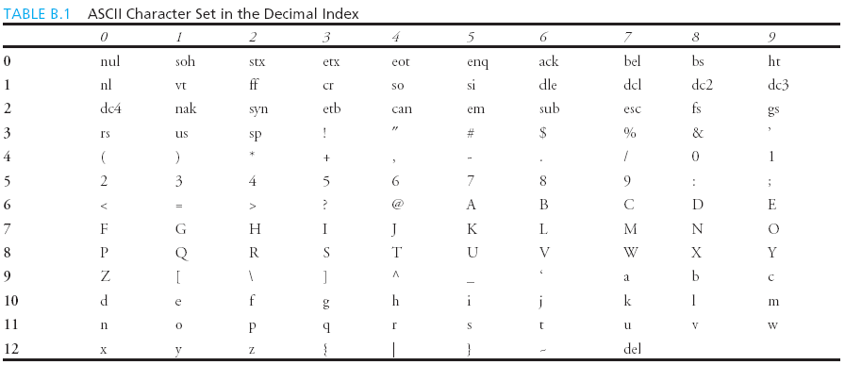
Appendix B: ASCII Character Set
ASCII Character Set is a subset of the Unicode from \u0000 to \u007f

Slide 14
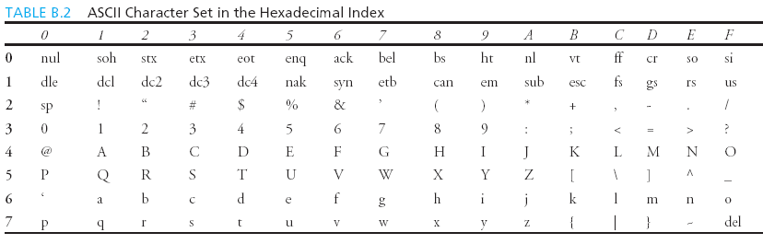
ASCII Character Set, cont.
ASCII Character Set is a subset of the Unicode from \u0000 to \u007f

Slide 15
Functions ord and chr
>>> ch = ‘a’
>>> ord(ch)
>>> 97
>>> chr(98)
>>> ‘b’
myletter = 'm'
ord(myletter)

Slide 16
Chat exercise
Convert character ‘H’ to its code
Convert the number 121 to its corresponding character.
ord(‘H’)
ch = ‘H’
ord(ch)
chr(121)

Slide 17
Escape Sequences for Special Characters
Description Escape Sequence Unicode
Backspace \b \u0008
Tab \t \u0009
Linefeed \n \u000A
Carriage return \r \u000D
Backslash \\ \u005C
Single Quote \' \u0027
Double Quote \" \u0022

Slide 18
Printing without the Newline
print(item, end = 'anyendingstring')
print("AAA", end = ' ')
print("BBB", end = '')
print("CCC", end = '***')
print("DDD", end = '***')

Slide 19
The str Function
The str function can be used to convert a number into a string. For example,
>>> s = str(4.4) # Convert a float to string
>>> s
'4.4'
>>> s = str(3) # Convert an integer to string
>>> s
'3'
>>>

Slide 20
The String Concatenation Operator
You can use the + operator add two numbers. The + operator can also be used to concatenate (combine) two strings. Here are some examples:
>>> message = "Welcome " + "to " + "Python"
>>> message
‘Welcome to Python'
>>> chapterNo = 2
>>> s = "Chapter " + str(chapterNo)
>>> print(s)
'Chapter 2'
>>>

Slide 21
Reading Strings from the Console
To read a string from the console, use the input function. For example, the following code reads three strings from the keyboard:
s1 = input("Enter a string: ")
s2 = input("Enter a string: ")
s3 = input("Enter a string: ")
print("s1 is " + s1)
print("s2 is " + s2)
print("s3 is " + s3)

Slide 22
Case Study: Minimum Number of Coins
This program lets the user enter the amount in decimal representing dollars and cents and output a report listing the monetary equivalent in single dollars, quarters, dimes, nickels, and pennies. Your program should report maximum number of dollars, then the maximum number of quarters, and so on, in this order.
ComputeChange

Slide 23
# Listing 2.5 ComputeChange.py
amount = float(input("Enter an amount, e.g., 11.56: "))
remainingAmount = int(amount * 100) # Convert the amount to cents
numberOfOneDollars = remainingAmount // 100. # number of one dollars
remainingAmount = remainingAmount % 100
numberOfQuarters = remainingAmount // 25 # Number of quarters in the remaining
remainingAmount = remainingAmount % 25
numberOfDimes = remainingAmount // 10 #number of dimes in the remaining
remainingAmount = remainingAmount % 10
numberOfNickels = remainingAmount // 5. #nickels in the remaining
remainingAmount = remainingAmount % 5
numberOfPennies = remainingAmount % 5. # pennies in the remaining
# Display results
print("Your amount", amount, "consists of"),
print(" ", numberOfOneDollars, "dollars"),
print(" ", numberOfQuarters, "quarters"),
print(" ", numberOfDimes, "dimes"),
print(" ", numberOfNickels, "nickels"),
print(" ", numberOfPennies, "pennies")

Slide 24
Introduction to Objects and Methods
In Python, all data—including numbers and strings—are actually objects.
An object is an entity. Each object has an id and a type. Objects of the same kind have the same type. You can use the id function and type function to get these information for an object.

Slide 25
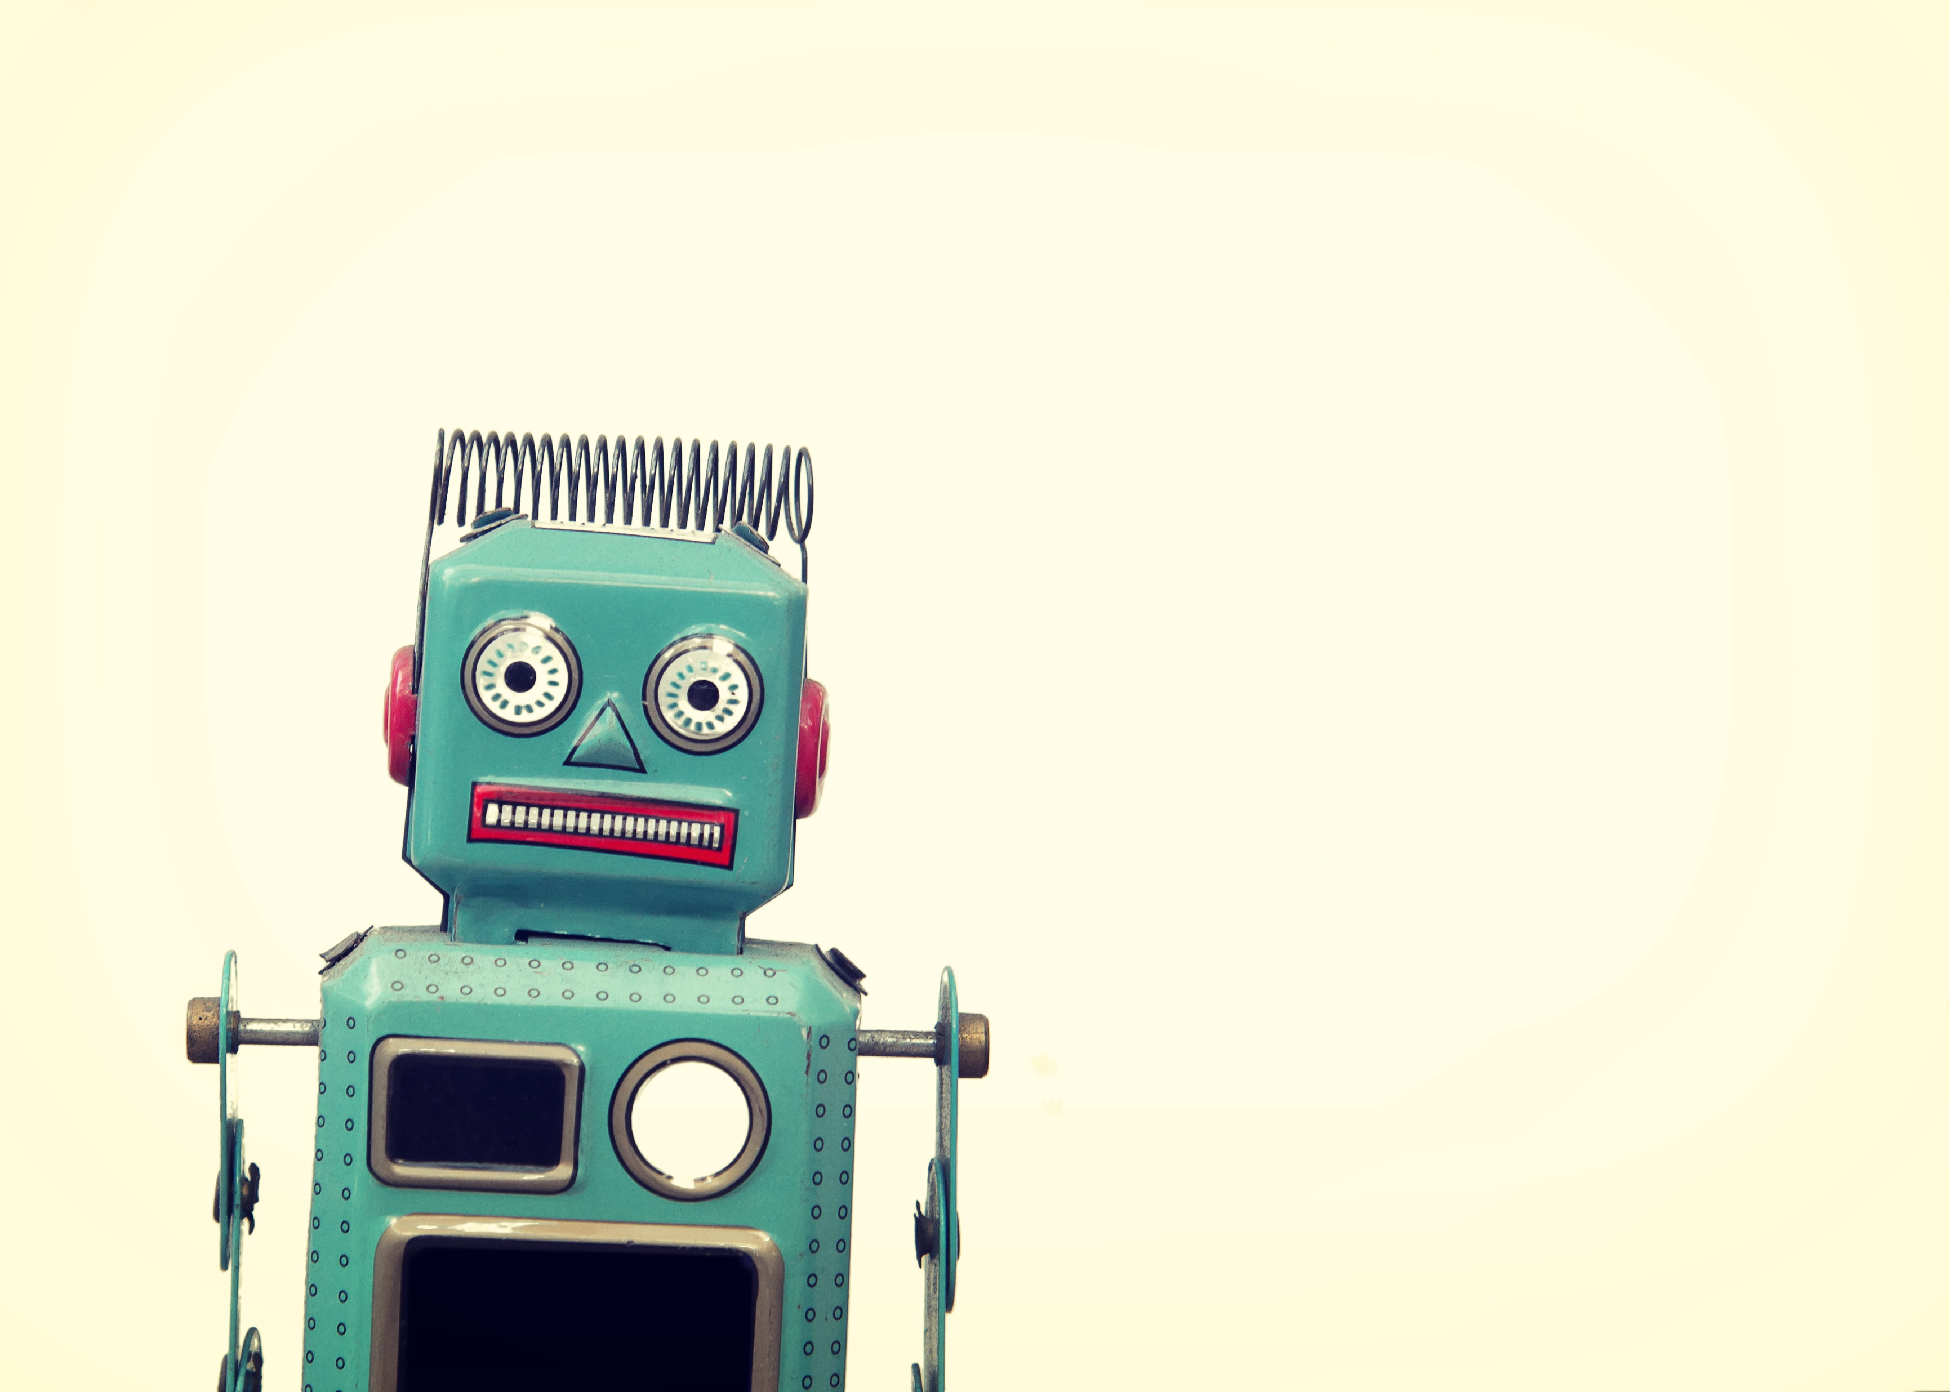
Footprint of an Object
Object ID | Data | Methods
 | Data1 | Method1 (i.e. function)
 | Data2 | Method2
Handle (variable name)

Slide 26
Object Types and Ids
The id and type functions are rarely used in programming, but they are good pedagogical tools for understanding objects.
>>> n = 3 # n is an integer
>>> id(n)
505408904
>>> type(n)
<class ’int’>
>>> f = 4.0 # f is a float
>>> id(f)
26647120
>>> type(f)
<class ’float’>
>>> s = "Welcome" # s is a string
>>> id(s)
36201472
>>> type(s)
<class ’str’>

Slide 27
OOP and str Objects
The id and type functions are rarely used in programming, but they are good pedagogical tools for understanding objects.

Slide 28
Object vs. Object reference Variable
For n = 3, we say n is an integer variable that holds value 3. Strictly speaking, n is a variable that references an int object for value 3. For simplicity, it is fine to say n is an int variable with value 3.

Slide 29
Methods
You can perform operations on an object. The operations are defined using functions. The functions for the objects are called methods in Python. Methods can only be invoked from a specific object. For example, the string type has the methods such as lower() and upper(), which returns a new string in lowercase and uppercase. Here are the examples to invoke these methods:

Slide 30
str Object Methods
>>> s = "Welcome"
>>> s1 = s.lower() # Invoke the lower method
>>> s1
'welcome'
>>> s2 = s.upper() # Invoke the upper method
>>> s2
'WELCOME'

Slide 31
Striping beginning and ending Whitespace Characters
Another useful string method is strip(), which can be used to strip the whitespace characters from the both ends of a string.
>>> s = "\t Welcome \n"
>>> s1 = s.strip() # Invoke the strip method
>>> s1
'Welcome'

Slide 32
Testing Strings

Slide 33
Searching for Substrings

Slide 34
Converting Strings

Slide 35
Striping Whitespace Characters

Slide 36
Problem: Guessing Birthday
The program can guess your birth date. Run to see how it works.
1: 00001 3:00011 5:00101
2: 00010 6:00110 7:00111
Live Example 4.6: GuessBirthday

Slide 37
Mathematics Basis for the Game
19 is 10011 in binary. 7 is 111 in binary. 23 is 11101 in binary

Slide 38
day = 0 # birth day to be determined
# Listing 4.6
# Prompt the user to answer the first question
question1 = "Is your birthday in Set1?\n" + \
" 1 3 5 7\n" + \
" 9 11 13 15\n" + \
"17 19 21 23\n" + \
"25 27 29 31" + \
"\nEnter n/N for No and y/Y for Yes: "
answer = input(question1)
# print("\nYour birthday is " + str(day) + "!")
if answer.upper() == 'Y':
day += 1
# Prompt the user to answer the second question
question2 = "\nIs your birthday in Set2?\n" + \
" 2 3 6 7\n" + \
"10 11 14 15\n" + \
"18 19 22 23\n" + \
"26 27 30 31" + \
"\nEnter n/N for No and y/Y for Yes: "
answer = input(question2)
if answer.upper() == 'Y':
day += 2
# Prompt the user to answer the third question
question3 = "\nIs your birthday in Set3?\n" + \
" 4 5 6 7\n" + \
"12 13 14 15\n" + \
"20 21 22 23\n" + \
"28 29 30 31" + \
"\nEnter n/N for No and y/Y for Yes: "
answer = input(question3)
if answer.upper() == 'Y':
day += 4
# Prompt the user to answer the fourth question
question4 = "\nIs your birthday in Set4?\n" + \
" 8 9 10 11\n" + \
"12 13 14 15\n" + \
"24 25 26 27\n" + \
"28 29 30 31" + \
"\nEnter n/N for No and y/Y for Yes: "
answer = input(question4)
if answer.upper() == 'Y':
day += 8
# Prompt the user to answer the fifth question
question5 = "\nIs your birthday in Set5?\n" + \
"16 17 18 19\n" + \
"20 21 22 23\n" + \
"24 25 26 27\n" + \
"28 29 30 31" + \
"\nEnter n/N for No and y/Y for Yes: "
answer = input(question5)
if answer.upper() == 'Y':
day += 16
print("\nYour birthday is " + str(day) + "!")

Slide 39
# Listing 4.6 continued
# Prompt the user to answer the second question
question2 = "\nIs your birthday in Set2?\n" + \
" 2 3 6 7\n" + \
"10 11 14 15\n" + \
"18 19 22 23\n" + \
"26 27 30 31" + \
"\nEnter n/N for No and y/Y for Yes: "
answer = input(question2)
if answer.upper() == 'Y':
day += 2
# Prompt the user to answer the third question
question3 = "\nIs your birthday in Set3?\n" + \
" 4 5 6 7\n" + \
"12 13 14 15\n" + \
"20 21 22 23\n" + \
"28 29 30 31" + \
"\nEnter n/N for No and y/Y for Yes: "
answer = input(question3)
if answer.upper() == 'Y':
day += 4

Slide 40
# Listing 4.6 continued
# Prompt the user to answer the fourth question
question4 = "\nIs your birthday in Set4?\n" + \
" 8 9 10 11\n" + \
"12 13 14 15\n" + \
"24 25 26 27\n" + \
"28 29 30 31" + \
"\nEnter n/N for No and y/Y for Yes: "
answer = input(question4)
if answer.upper() == 'Y':
day += 8
# Prompt the user to answer the fifth question
question5 = "\nIs your birthday in Set5?\n" + \
"16 17 18 19\n" + \
"20 21 22 23\n" + \
"24 25 26 27\n" + \
"28 29 30 31" + \
"\nEnter n/N for No and y/Y for Yes: "
answer = input(question5)
if answer.upper() == 'Y':
day += 16
print("\nYour birthday is " + str(day) + "!")

Slide 41
Formatting Numbers and Strings
Often it is desirable to display numbers in certain format. For example, the following code computes the interest, given the amount and the annual interest rate.
The format function formats a number or a string and returns a string.
format(item, format-specifier)

Slide 42
Formatting Floating-Point Numbers

Slide 43
Formatting in Scientific Notation
If you change the conversion code from f to e, the number will be formatted in scientific notation. For example,
print(format(57.467657, '10.2e'))
print(format(0.0033923, '10.2e'))
print(format(57.4, '10.2e'))
print(format(57, '10.2e'))

Slide 44
Formatting as a Percentage
You can use the conversion code % to format numbers as a percentage (i.e. multiply by 100 and add %). For example,
print(format(0.53457, '10.2%'))
print(format(0.0033923, '10.2%'))
print(format(7.4, '10.2%'))
print(format(57, '10.2%'))

Slide 45
Justifying Format
By default, the format is right justified. You can put the symbol < in the format specifier to specify that the item is a left justified in the resulting format within the specified width. For example,
print(format(57.467657, '10.2f'))
print(format(57.467657, '<10.2f'))

Slide 46
Formatting Integers
You can use the conversion code d, x, o, and b to format an integer in decimal, hexadecimal, octal, or binary. You can specify a width for the conversion. For example,
print(format(59832, '10d'))
print(format(59832, '<10d'))
print(format(59832, '10x'))
print(format(59832, '<10x'))

Slide 47
Formatting Strings
You can use the conversion code s to format a string with a specified width. For example,
print(format("Welcome to Python", '20s'))
print(format("Welcome to Python", '<20s'))
print(format("Welcome to Python", '>20s'))

Slide 48
Drawing Various Shapes
A turtle contains methods for moving the pen and setting the pen’s size and speed.

Slide 49
Turtle Pen Drawing State Methods

Slide 50
Turtle Motion Methods

Slide 51
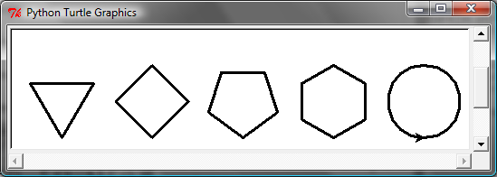
Problem: Draw Simple Shapes
SimpleShapes

Slide 52
Turtle Drawing with Colors and Fonts

Slide 53
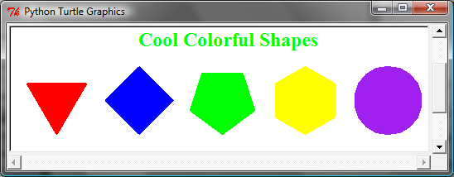
Drawing with Colors and Fonts
A turtle object contains the methods for setting colors and fonts.
Live Example 4.10 ColorShapes

